Slide 1
eScript

Slide 2
Introduction
Language Overview
Imp Objects, Methods, Events
Example

Slide 3
Definition
Siebel eScript is a scripting language that allows an applications developer to write simple scripts to extend Siebel applications.
JavaScript, is its core language.

Slide 4
You should regard coding as a last resort
Siebel Tools provides many ways to configure your Siebel application without coding, and these methods should be checked before you attempt to write your own code, for three reasons:
 It’s easier to use Siebel Tools than it is to write code.
 More important, your code may not survive an upgrade.
 Finally, declarative configuration through Siebel Tools results in better performance than implementing the same functionality through code.

Slide 5
Who should use this?
Persons who plan, implement, and configure Siebel applications, adding new functionality.
Ex: Validation, Deleting data from database or using VBC or a new workflow process.
Programmers with experience in other languages can use this.

Slide 6
What’s New?
Siebel 7 developers can use Siebel VB and Siebel eScript simultaneously in the same environment.
Browser Scripting is added in Siebel 7.
(recommended only for high interactive application)

Slide 7
Advantage of eScript
eScript is supported by Unix but Siebel-VB is not.

Slide 8
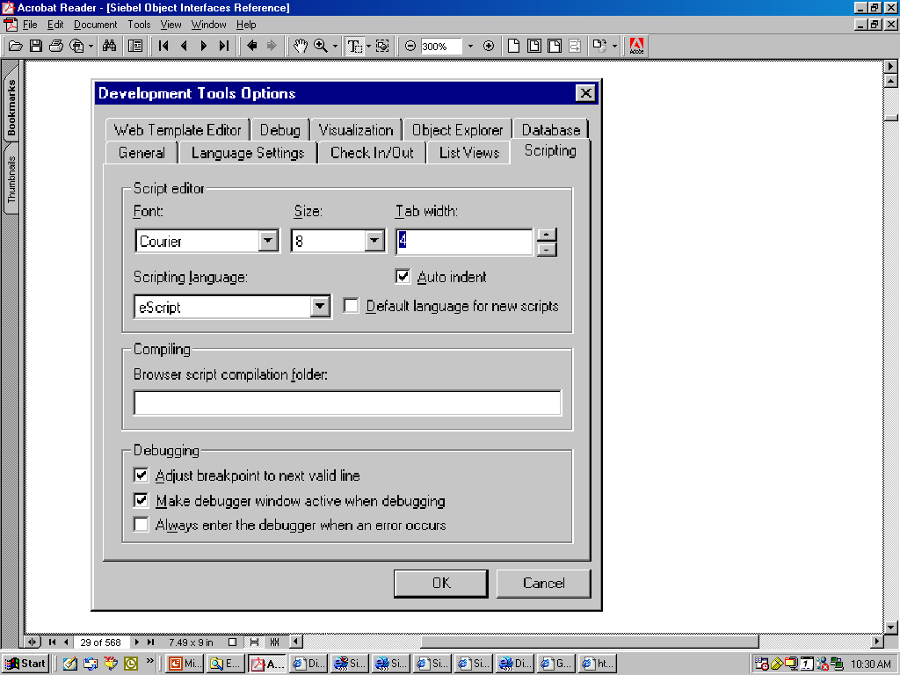
Choose View > Options > Scripting tab >Scripting Language.

Slide 9
Siebel eScript is an enhanced configuration environment that includes:
 An editing environment

Slide 10
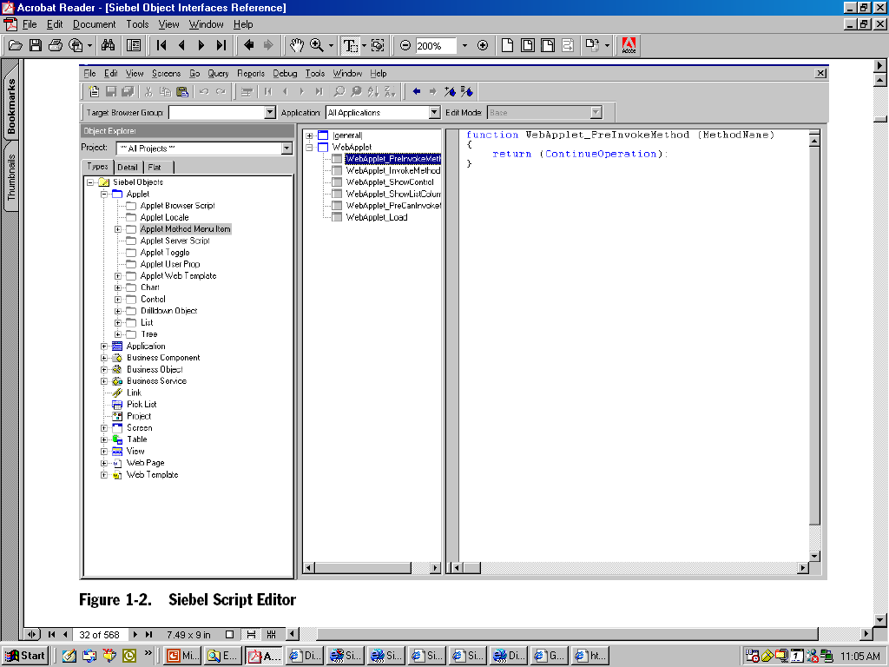

Slide 11
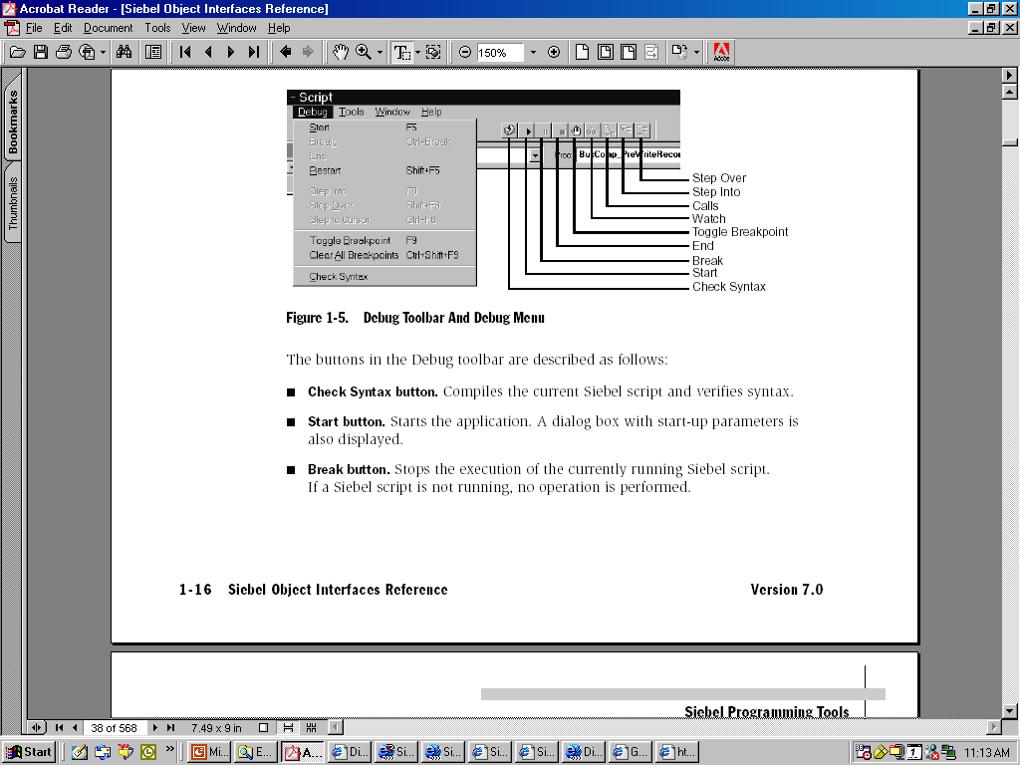
A debugger to assist in detecting errors

Slide 12
A compiler for the custom Siebel eScript routines
When compiling a project containing object definitions with associated Siebel scripts.
returns a message when completed that indicates success or failure.

Slide 13
Siebel scripts can be attached to the object types
Application
Applet
Business Component

Slide 14
Siebel eScript Language Overview
Declare Variables : “var”
Case Sensitive: ”A” is different then “a”
Use parentheses () with all functions
The this object reference.
“the current object.”

Slide 15
Destroy any objects you have created when you no longer need them.
To destroy an object in Siebel eScript, set it to null, or set the variable containing it
to another value. The best practice is to
destroy objects in the order opposite to the
order of creation.

Slide 16
White-Space Characters:
Siebel eScript interpreter ignores it.
var x=a+b
var x = a + b
var x = a + b
var x = a+
b

Slide 17
White space separates identifiers into separate entities.
For example, ab is one variable name, and
a b is two.
var ab = 2 is valid, but
var a b = 2 is not.

Slide 18
Comments
//This is comments
/* this for block , more then one line
2
3 */

Slide 19
Expressions, Statements, and Blocks
An expression or statement is any sequence of code that performs a computation or an action, such as
var TestSum = 4 + 3, which computes a sum and assigns it to a variable.

Slide 20
Identifiers
Is names for variables and functions.
Rules for Identifiers : can contain only this
ABCDEFGHIJKLMNOPQRSTUVWXYZ
abcdefghijklmnopqrstuvwxyz
0123456789
_$ and should not start with digit.
Prohibited Identifiers: All keywords.

Slide 21
Variables
A variable is an identifier to which data may be assigned.
Variable Scope
Local: declare inside the Function
Global: outside, so global for that module or Object.

Slide 22
Data Types 2
primitive
composite
special

Slide 23
Primitative Data Type
The primitive data types are number, Boolean, and string.

Slide 24
Composite Data Type
Two commonly used composite data types are Object and Array.

Slide 25
Special Data Type
Undefined
NULL
NaN

Slide 26
Automatic Type Conversion
Subtraction : String changes to Number
ex var a = “5”
Var b = 3
var c = a – b
c = 2
Addition : Number to String

Slide 27
Properties and Methods of Basic Data Types
toString()
This method returns the value of a variable expressed as a string.
ex: var number = 5
var s = number.toString()
valueOf()
This method returns the value of a variable.

Slide 28
Expressions
An expression is a collection of two or more terms that perform a mathematical or logical operation.

Slide 29
Operators
Arithmetic operators ex
Basic Arithmetic : =, +, -
Assignment Arithmetic: += , -=
i = 2; //i is now 2
i += 3; //i is now 5 (2 + 3),
Auto-increment (++) and Auto-decrement (--)
i = 4; //i is 4
j = ++i; //j is 5, i is 5 (i was incremented before use)
j = i++; //j is 5, i is 6 (i was incremented after use)

Slide 30
Logical operators ex: !, &&, ||
Conditional Operator
test_expression ? expression_if_true : expression_if_false
String Concatenation Operator
+

Slide 31
Functions
A function is an independent section of code that receives information from a program and performs some action with it.
Once a function has been written, U Just call the function, and let it handle the work for you.
TheApplication().RaiseErrorText is an example of a function

Slide 32
functions are declared with the function keyword,
and functions have the function operator, a pair of parentheses,

Slide 33
Function Scope
Functions are global in scope and can be called from anywhere in a script.

Slide 34
Statements
that allow program to make decisions and to direct the flow based on those decisions.
break Statement
continue Statement
do...while Statement
for Statement
goto Statement

Slide 35
if Statement
switch Statement
throw Statement
try Statement
while Statement 2
with Statement

Slide 36
Language Reference
Imp Objects And Methods associated those objects

Slide 37
Applet Object
BusComp() Method: returns the business component that is associated with the applet.
var applet;
var myBusComp;
myBusComp = applet.BusComp();

Slide 38
BusObject() Method: returns the business object for the business component for the applet.
var applet;
var busObject;
busObject = applet.BusObject();

Slide 39
Name(): Returns the name of the applet.
var applet;
var sApplet;
sApplet = applet.Name();

Slide 40
InvokeMethod()
The InvokeMethod() method calls an argument-specified specialized method.
WebApplet_InvokeMethod() Event 3
The InvokeMethod() event is called after a specialized method or a user-defined
method on the web applet has been executed.

Slide 41
WebApplet_Load() Event
The WebApplet_Load() event is triggered just after an applet is loaded.
WebApplet_PreCanInvokeMethod() Event
The PreCanInvokeMethod() event is called before the PreInvokeMethod, allowing the developer to determine whether or not the user has the authority to invoke a specified WebApplet method.
Notes:
This Slides Are Really GOOD.......................

Slide 42
WebApplet_PreInvokeMethod() Event
The PreInvokeMethod() event is called before a specialized method for the web applet is invoked by the system.

Slide 43
Application
The application object represents the Siebel application that is currently active.
ActiveBusObject() Method: returns the business object for the business component for the
active applet.
ActiveViewName() Method: returns the name of the active view.
Application_Close() Event: The Close() event is called before the application exits.
Business Component
Business Object
Business Service

Slide 44
GetProfileAttr() Method: returns the value of an attribute in a user profile.
GetService() Method: returns a specified business service. If the service is not already running, it will be constructed.
GetSharedGlobal() Method: gets the shared user-defined global variables.
LoginId() Method
LoginName() Method

Slide 45
Business Component Objects
ActivateField() Method
allows queries to retrieve data for the field specified in its argument.
ActivateMultipleFields() Method
allows users to activate the fields specified in the property set input argument.

Slide 46
BusComp_ChangeRecord() Event
is called after a record becomes the current row in the business component.
BusComp_CopyRecord() Event
is called after a row has been copied in the business component and that row has been made active.

Slide 47
BusComp_DeleteRecord() Event
is called after a row is deleted. The current context is a different row (the Fields of the just-deleted row are no longer available).
BusComp_InvokeMethod() Event
The InvokeMethod() event is called when the InvokeMethod method is called on a
business component.

Slide 48
BusComp_PreInvokeMethod() Event
is called before a specialized method is invoked on the business component.
BusComp_Query() Event
is called just after the query is complete and all the rows have been retrieved, but before the rows are actually displayed.

Slide 49
BusObject() Method
returns the business object that contains the business component.
ClearToQuery() Method
clears the current query and sort specifications on the business component.

Slide 50
ExecuteQuery() Method
returns a set of business component records using the criteria established with methods such as SetSearchSpec.
FirstRecord() Method 3
moves the record pointer to the first record in a business component, making that record current and invoking any associated script events.

Slide 51
GetViewMode() Method
returns the current visibility mode for the business component. This affects which records are returned by queries according to the visibility rules.
LastRecord() Method 3
Name() Method

Slide 52
SetFieldValue() Method
assigns the new value to the named field for the current row of the business component.
SetSearchSpec() Method 3
sets the search specification for a particular field. This method must be called before ExecuteQuery.

Slide 53
SetSortSpec() Method
SetSortSpec() sets the sorting specification for a query.
WriteRecord() Method
commits to the database any changes made to the current record.

Slide 54
SetViewMode() Method Sets the visibility type for the business component.
0 (or SalesRepView)
1 (or ManagerView)
 2 (or PersonalView)
 3 (or AllView)
 5 (or OrganizationView)
 6 (or ContactView)
 7 (or GroupView)
 8 (or CatalogView)
 9 (or SubOrganizationView)

Slide 55
Other Objects
Array Objects
Buffer Objects
Business Object Objects
Business Service Objects
The Date Object
The Math Object

Slide 56
Scenario:
There is a button on the Quote Screen Order view: on clicking Order gets created.

Slide 57
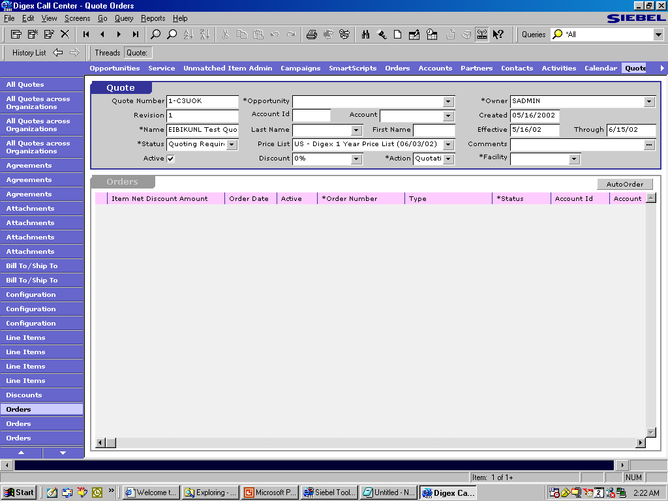

Slide 58
In Tools Configuration:
Control----→ with Caption----→AutoOrder
→method invoke ----→AutoOrder

Slide 59
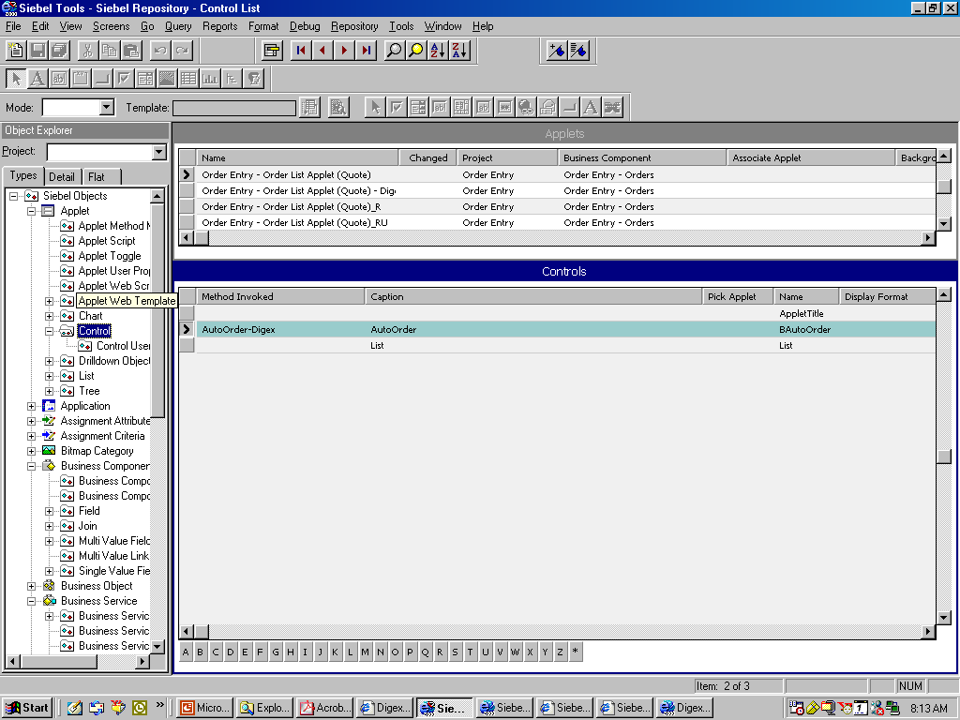

Slide 60
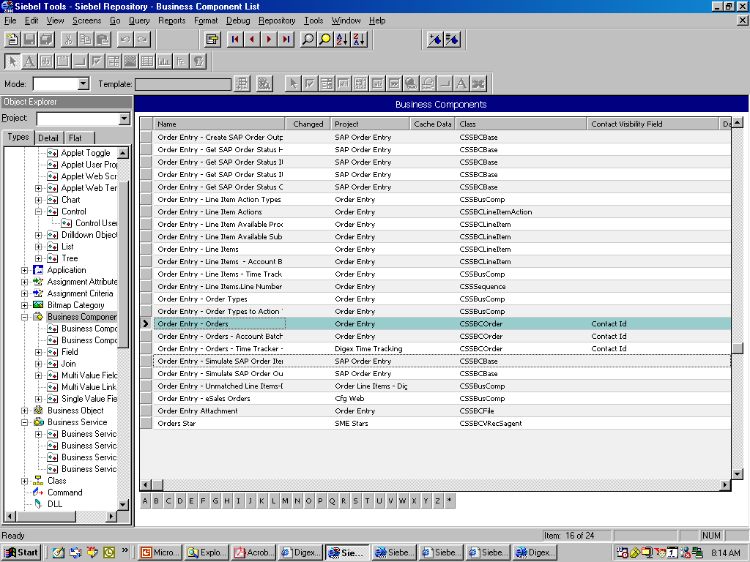

Slide 61
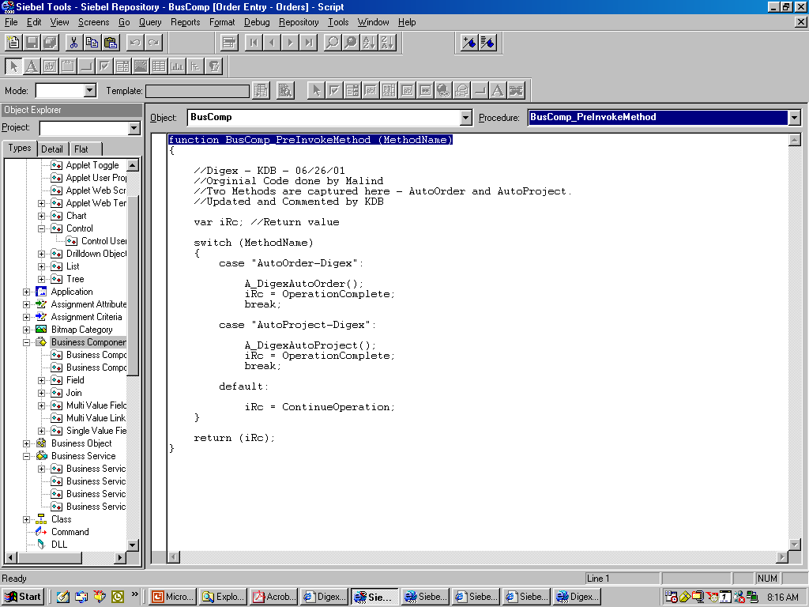

Slide 62
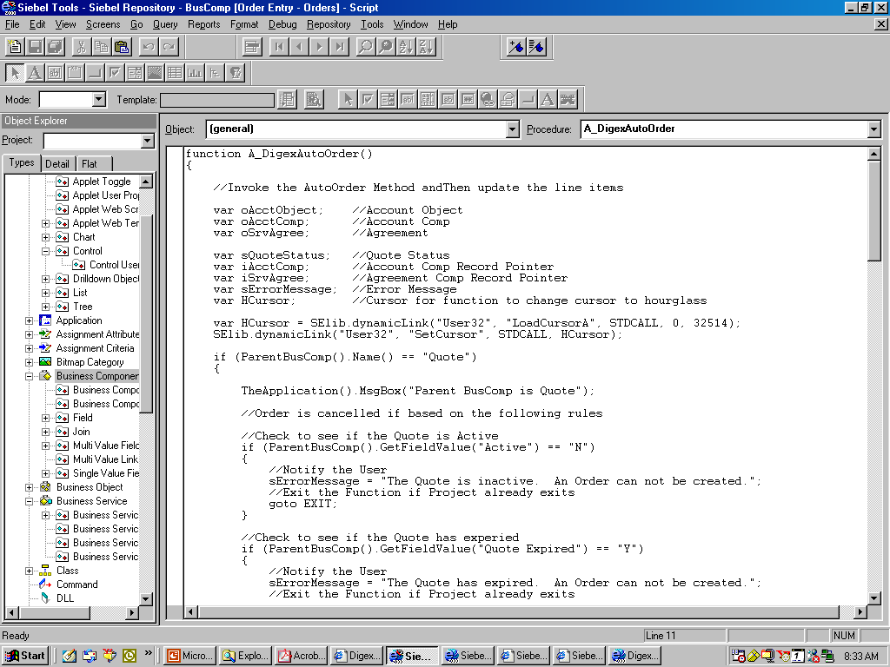

Slide 63
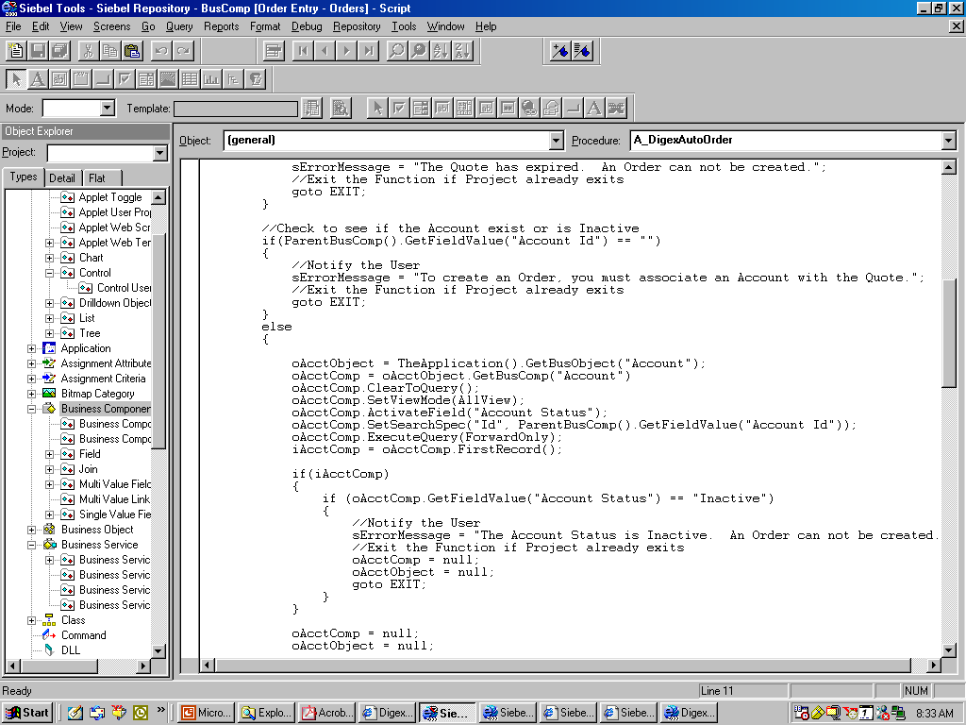

Slide 64
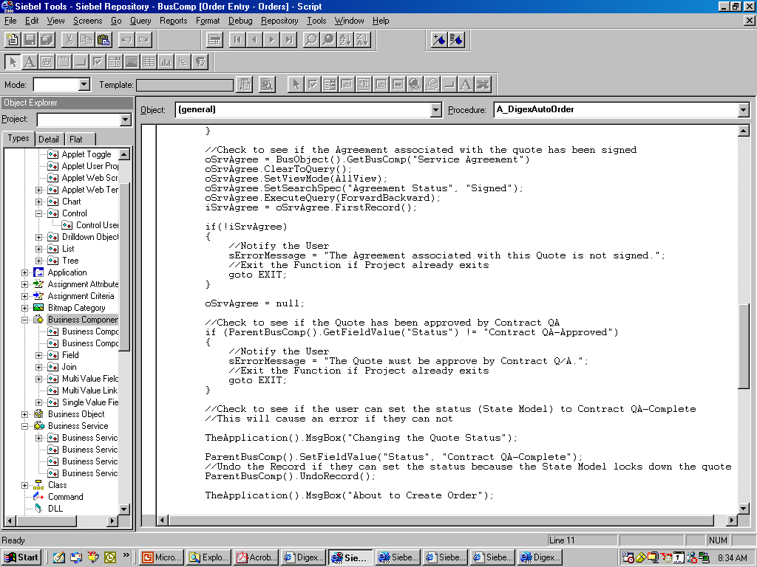

Slide 65
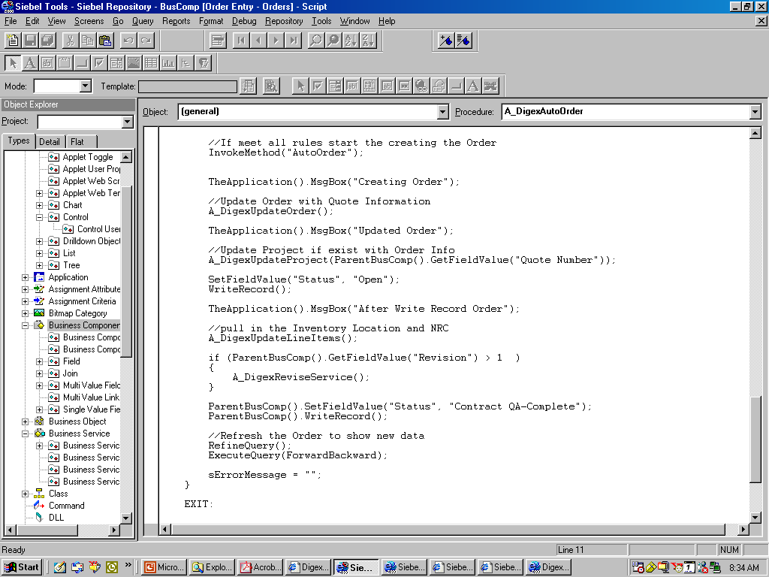

Slide 66
Thank You

